Slide 1
OUTLINE
Student Details
Project Title/Problem Statement
Agenda
Project Overview
Who are the End Users of this Project
Your Solution and its Value Proposition
How did you Customize the Project and make it your Own
Modelling
Results
Links(ex: GitHub)

Slide 2
Students details
Name: Roda chinthapalli
College name: SRM University AP
Roll number: AP22110011496
Personal mail id: rodachinthapalli@gmail.com
College mail id: roda_chinthapalli@srmap.edu.in

Slide 3
Project title
Image Steganography for Hiding Text in Images

Slide 4

Agenda
To understand and implement the basics of steganography.
To create a program that can hide a text message inside an image.
To retrieve and decode the hidden message from the image.

Slide 5
Project overview
This project involves implementing an image steganography tool in Python using the PIL library. The tool allows users to encode (hide) text messages inside images and decode (extract) hidden messages from images. The primary goal is to ensure that the message is concealed in a way that does not noticeably alter the image to the naked eye

Slide 6
WHO ARE THE END USERS OF THIS PROJECT
Individuals who need to securely hide and transmit confidential messages
Digital artists and content creators who want to hide metadata or signatures in their work in creative ways.
Cybersecurity professionals interested in steganography techniques.

Slide 7
How did you Customize the Project and make it your Own
Adapted the code to work with audio files in addition to images, allowing messages to be hidden within sound.
. Simplified and organized the code for easier understanding and maintenance.
Improved the user interface to make it easier to select different media types for steganography.

Slide 8
MODELLING
Data Encoding: Converts text data to binary and modifies pixel values to store the binary data.
Data Decoding: Reads pixel values, extracts binary data, and converts it back to text.

Slide 9
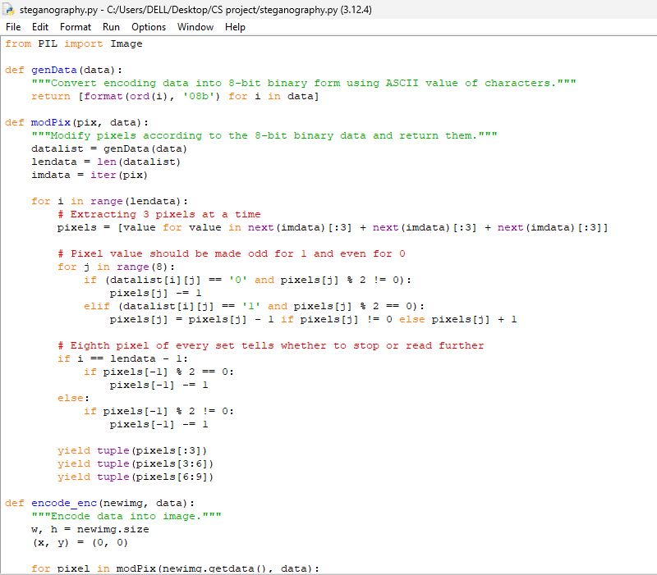
CODE

Slide 10
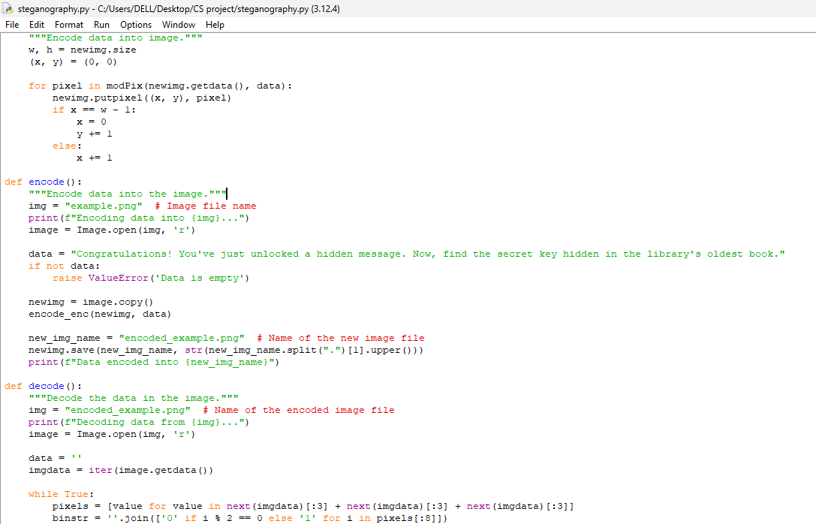

Slide 11
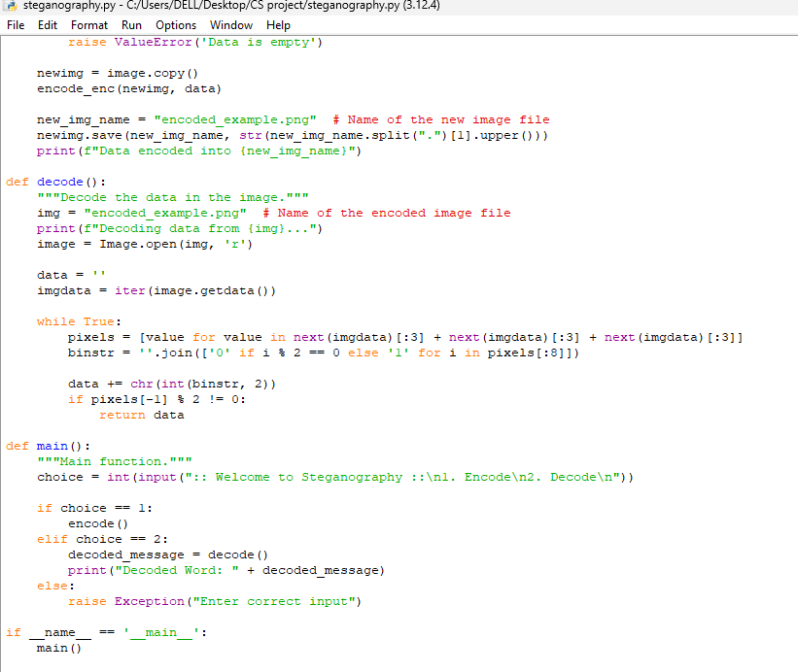

Slide 12
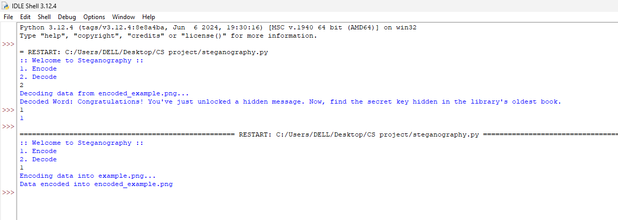
OUTPUT

Slide 13

Example for encoded
Congratulations! You've just unlocked a hidden message. Now, find the secret key hidden in the library's oldest book. secret key hidden in the library's oldest book.
image
TEXT
Hiden text in an image

Slide 14
Example for decoded
Congratulations! You've just unlocked a hidden message. Now, find the secret key hidden in the library's oldest book.
Hiden text in an image
image
Secret message

Slide 15
RESULTS
Successfully encoded and decoded messages without noticeable alteration to the image.
The program works efficiently with various image formats and sizes.

Slide 16
Links
GitHub: https://github.com/Roda1458/Image-Steganography-for-Hiding-Text-in-Images.git
 | thankyou | -Roda Chinthapalli

